Slide 1

Distributed Cloud Computing
NetApp BlueXP

Slide 2


NetApp BlueXP
Cloud Computing has become a key technology driving innovation and development in the information industry
Managing all the different cloud services is a challenge
NetApp BlueXP lets you build, protect, and govern your hybrid multicloud data estate

Slide 3
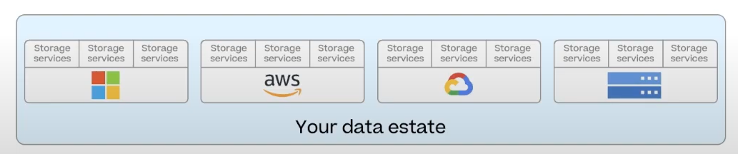
Data Estate
A data estate refers to the entirety of an organization's data assets, stored across various repositories and systems.
It encompasses all data sources, storage systems, processing and analytics capabilities, as well as the policies and procedures governing data management within an organization.

Slide 4
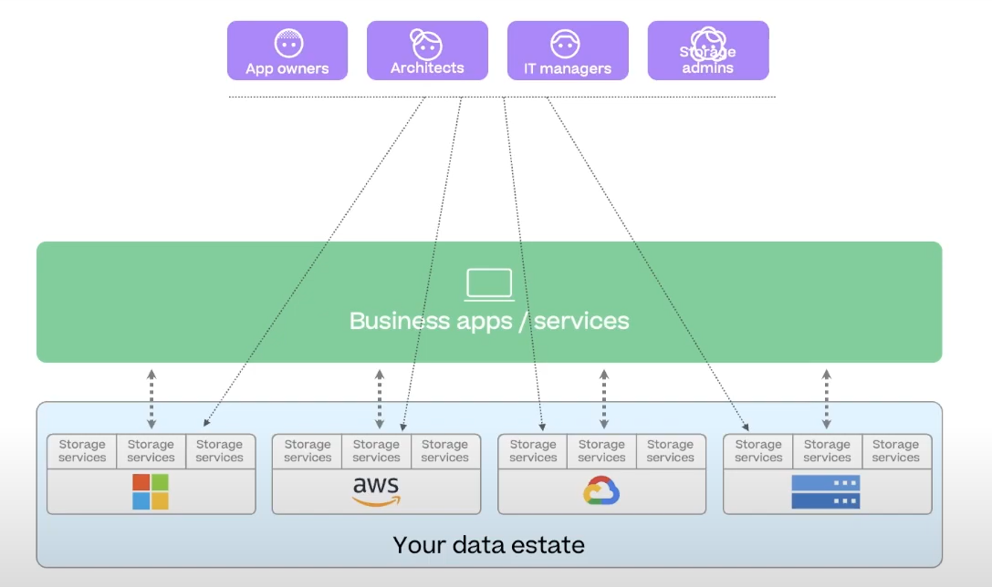
Without NetApp BlueXP
Managing different data resources is challenging for the END User, because they have different UI for each resource, and they do not integrate

Slide 5
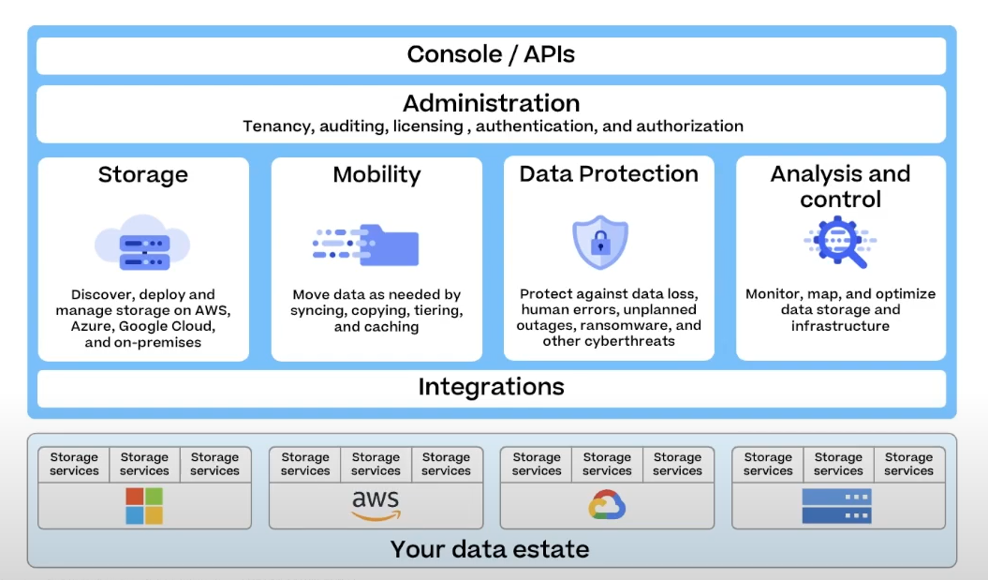
With NetApp BlueXP
NetApp BlueXP lets you build and operate an efficient, resilient, secure, and performant hybrid multicloud data estate through a single control plane

Slide 6
With NetApp BlueXP
Your data estate is your organization’s combined storage infrastructure and the data stored in it. It’s like your IT stack, but for data.
Your data estate is constantly growing and expanding across on-premises and multiple clouds.
As your data estate expands and evolves, it gets more and more complex.
You will need a way to ensure that you have methods to easily and efficiently
Build
Protect
Govern

Slide 7
WHY NetApp BlueXP
Build the foundation of your data estate by discovering, deploying, and managing storage, and moving data to the storage you’ve discovered or created
Protect the data estate against data loss and cyber threats by consistently applying enterprise-grade resilience and security
Govern your data estate with full visibility into the health, usage, and performance of your data across all locations and environments
BlueXP is designed to make these data estate operations simpler and robust
Build
Protect
Govern

Slide 8
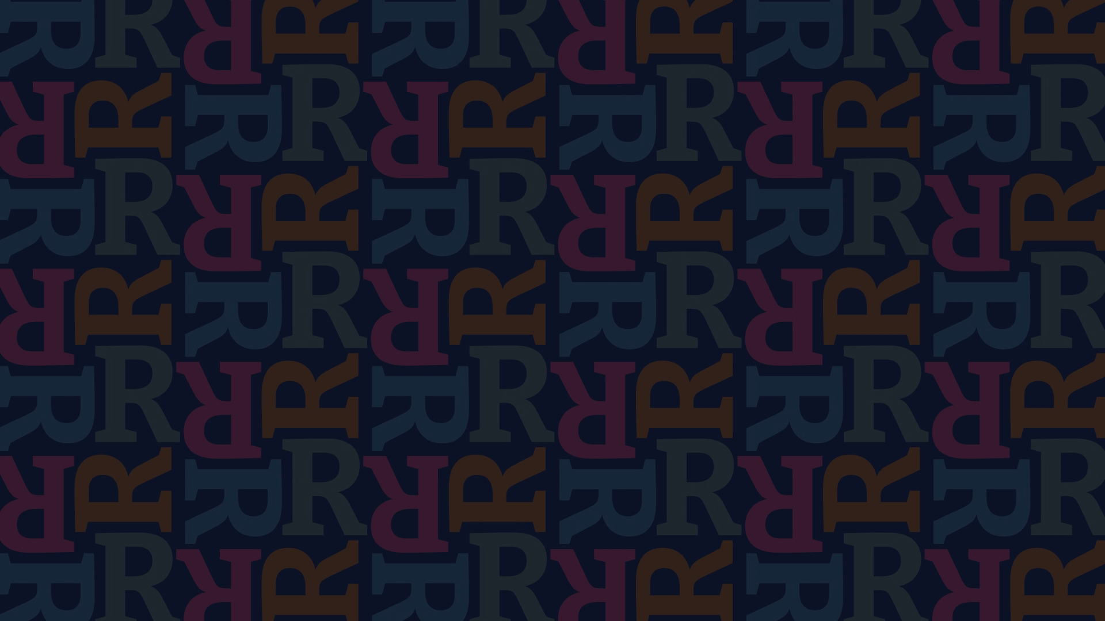
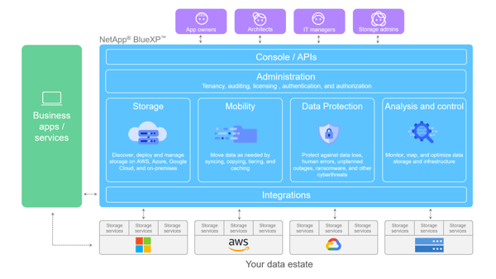
NetApp BlueXP platform provides four main pillars of data management
PROTECTION
STORAGE
Protection puts automated protection mechanisms in place so you can protect data against data loss, unplanned outages, ransomware, and other cyber threats.
Storage lets you discover, deploy, and manage storage, whether it’s on AWS, Azure, Google Cloud, or on premises.
MOBILITY
ANALYSIS and CONTROL
Mobility helps you move data where it’s needed by syncing, copying, tiering, and caching data.
Analysis and Control gives you tools to monitor, map, and optimize your data storage and infrastructure.

Slide 9
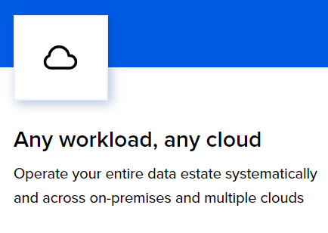
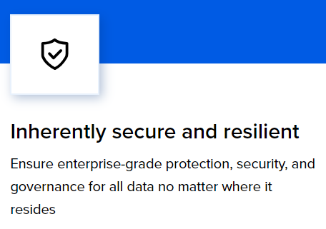
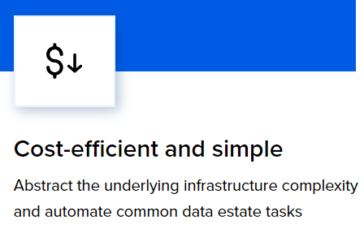
BENEFITS

Slide 10
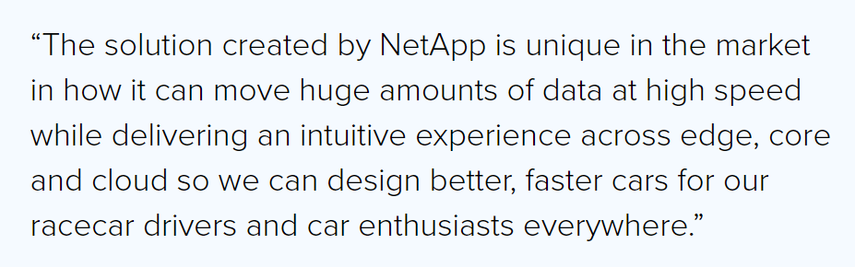
CASE STUDY
TAG Heuer Porsche Formula E Team
The hybrid cloud solution combines NAS storage with Global File Cache to ensure seamless data flow between different widely dispersed locations
(Data collected at Grand Prix racetrack AND Cloud Center at Weissach, Germany).
It integrates NetApp data services to ensure version consistency, manage and monitor cloud resources, and protect Porsche’s intellectual property

Slide 11
DEMO

Slide 12
THANK YOU

